Slide 1
Outline
K8s App Deployment Methods! Helm & Charts ....



Demo – helm in GKE*

Slide 2
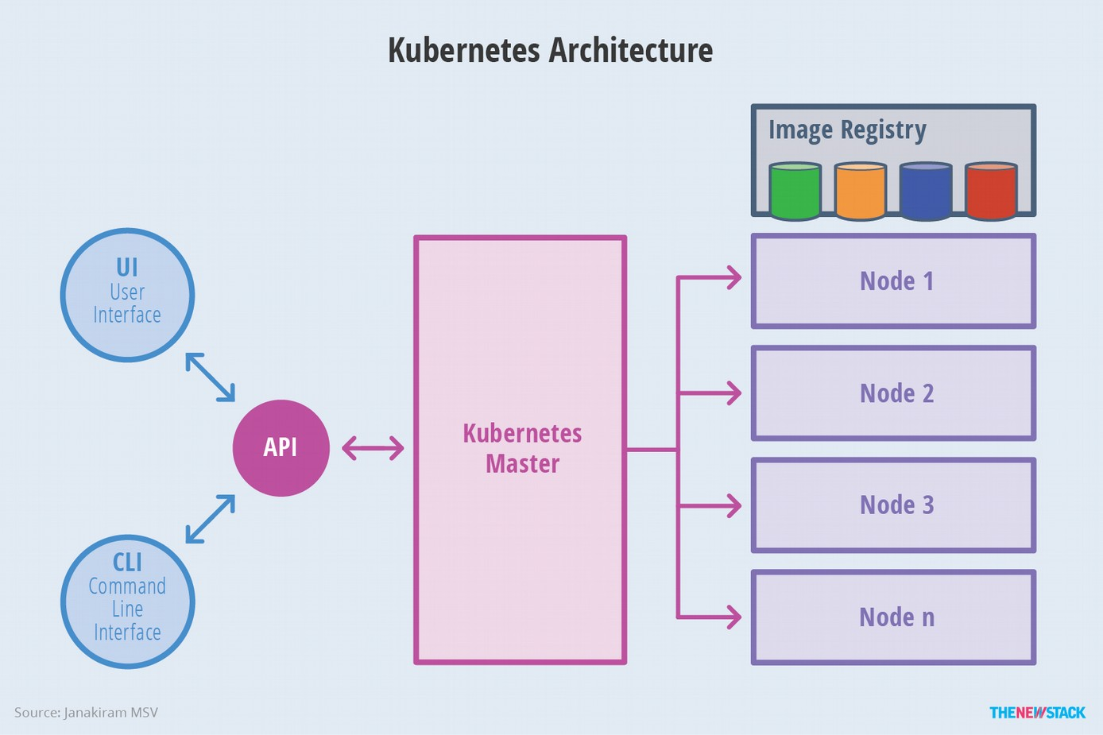
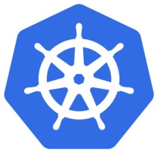
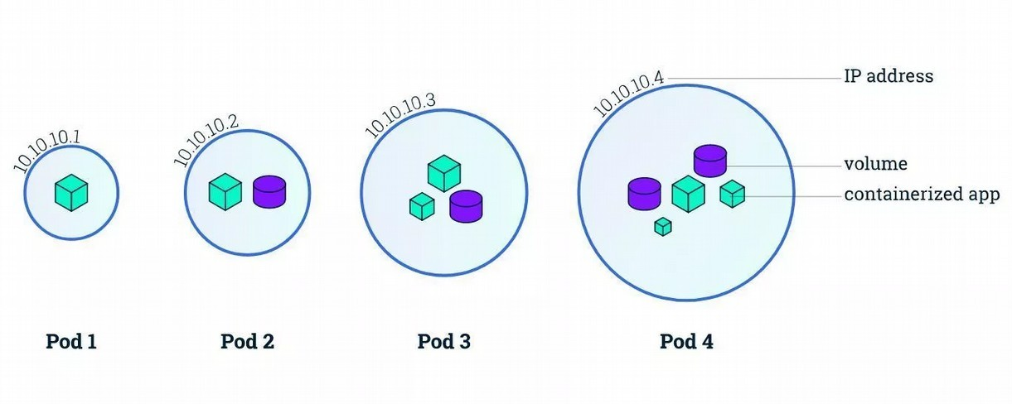
What’s in Kubernetes ?

Kubernetes: Container Orchestration Engine – abstracts underlying resources to deploy workloads

Micro Services: A fully functional software feature independently accessed as a service

Docker: Package applications in containers
CNCF: Cloud Native Computing Foundation: https://cncf.io

Kubenetes – helmsman(pilot);

Slide 3
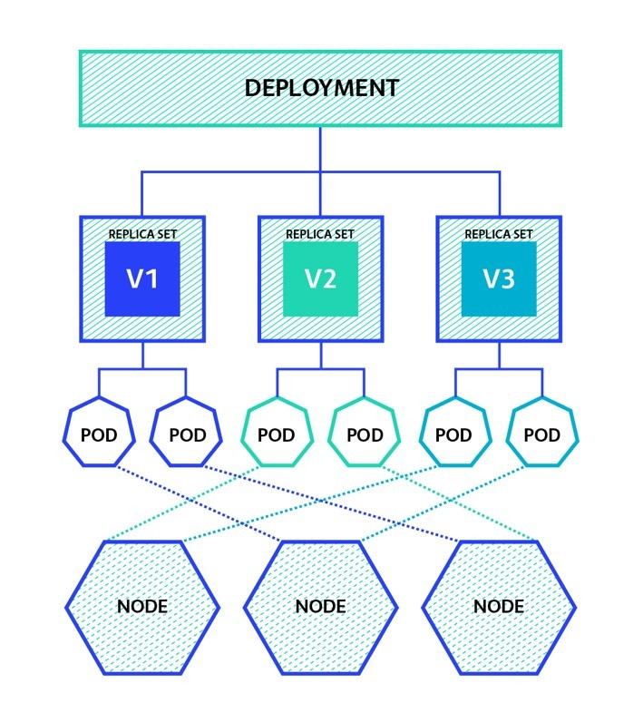
K8s Application Deployment File
kubectl apply -f deployment.yaml
<deployment.yaml>
apiVersion: apps/v1 kind: Deployment metadata:
name: nginx-deployment
labels:
app: nginx spec:
replicas: 3 selector: matchLabels:
app: nginx
template: metadata: labels:
app: nginx spec: containers:
- name: nginx image: nginx:1.7.9
ports:
- containerPort: 80
nginx – application for load balancer
3 pods will be created; one for each replica map of {key,value} pairs
indicates that the Pods run one container nginx Docker Hub image at version 1.7.9 Application Service port: 80

Slide 4
Application Deployment methods
blue/green: New version alongside old version then switching at one point; Rollout/Rollback
canary: Release a new version to few users and then decide full rollout based on result
a/b testing: Feature testing based on statistics; dark deployment that users are unaware of update rolling: Update new version one after another slowly with no downtime
recreate: Create a new one and kill the old one; best for development environments shadow: Both versions are running parallel with not impacting other; mocking services
& dependecies like ......
types: Stateless, Statefull, Affinity/Antiaffinity, Declarative/Imperative clusters: Multi Cluster, Hybrid Cloud, Multi Cloud
mechanics: Manual, Batch, Package Manager, CI/CD

Slide 5
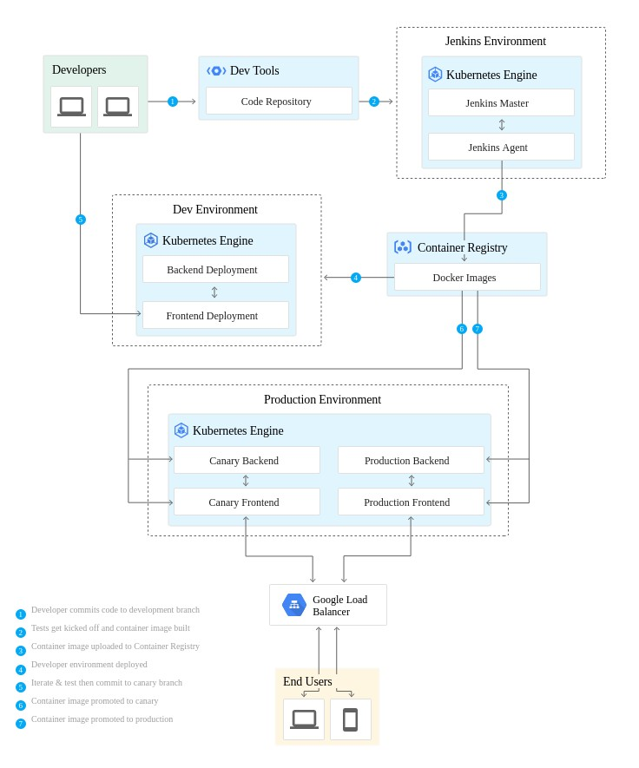
DevOps Pipeline
DevOps helps: infrastructure as code continuous integration continuous deployment automated release
And do:
•
Setup in k8s Clusters – Jenkin, Dev & Prod Production environment with Loadbalancer Create two namesapces - production & canary Create jenkin job, build & push to Registry Deploy Canary release (dev, prod, etc.)
And production release And more....
•
•
•
●
●
●
https://cloud.google.com/solutions/continuous-delivery-jenkins-kubernetes-engine

Slide 6
K8s Application Deployment/Automation Tools...
Kubectl Kustomize CNAB
Skaffold
Spinnakar Kudo Kompose Draft Brigade Kashti Jenkin Github Helm
– Create, manage and deploy k8s artifacts - https://kubernetes.io/docs/reference/kubectl/
A template-free way to customize application configuration - https://kustomize.io/
Cloud Native Application Bundling - https://cnab.io/
building, pushing and deploying your application - https://skaffold.dev/
– Multi cloud continous delivery - https://www.spinnaker.io/
- Universal declarative Operator - https://kudo.dev
Move docker file to k8s objects - http://kompose.io/
Streamlined k8s Deployment - https://draft.sh/
Event driven scripting for k8s - https://brigade.sh/
Visualization Dashboard for Brigade - https://github.com/brigadecore/kashti
k8s plugin & Jenkin X - https://github.com/jenkinsci/kubernetes-plugin
Marketplace for tools - https://github.com/marketplace/category/continuous-integration
– The package manager for k8s - https://helm.sh/

Slide 7
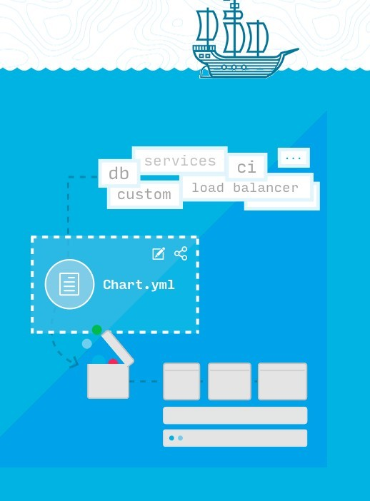
What is Helm?
Helm is a package manager, helps you manage Kubernetes applications — define, install, and upgrade even the most complex Kubernetes application.
Helm is like apt or yum in linux world
Why do we need a package manager
●
Application focused Better control
Container version handling - upgrade/rollback Manage dependencies
Reproducible and shareable
●
●
●
Helm initially started with Deis (now with Microsoft) & then Google Deployment Manger team joined to create helm2. Helm is now in CNCF Incubation project - https://helm.sh/
Helm - wheel

Slide 8
Charts
Chart - Charts are curated application definitions for Helm.
A chart is organized as a collection of files inside of a directory - that is package.
Charts are placed in repository similar to Docker Registry, Quay, etc.
●
Helm’s own Chart Museum - https://chartmuseum.com/ CNCF Project Harbor - https://goharbor.io/
Gihub charts - https://github.com/helm/charts
Helm Hub: Charts hosted in many distributed repositories - https://hub.helm.sh/
●
●
●
Helm manages charts, versions and releases Instance of application - Helm Release

Slide 9
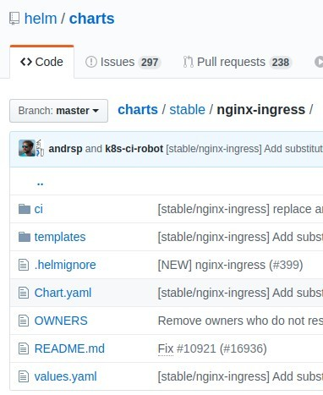
Sample Chart
https://github.com/helm/charts
/<projectName> - Name of the chart
●
chart.yaml – Information about chart values.yaml – default configuration values LICENSE – license for the chart README.md – human readable text
requirements.yaml – dependencies for the chart requirements.lock – lock the same version in requiremnts
/charts/ - dependencies chart upon which this chart depends
/templates/ - files in go template language
●
●
●
●
●
●
●
helm install stable/nginx-ingress --> will install nginx in k8s cluster

Slide 10
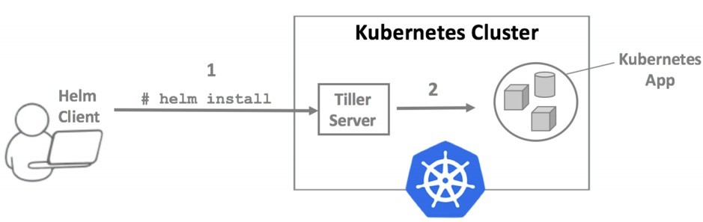
Helm Releases v2 (v2.14.3)
Released in 2016 (Currently production/maintenance)
A server in-cluster component was called Tiller, and it handled installing and managing Helm charts.
In Helm 2, install created v1, a subsequent upgrade created v2, and so on. In Tiller name space you can store only one instanace name
Later Kubernetes introduced RBAC & CRDs.
With RBAC, locking down Tiller in production becomes difficult; so start providing permissive default configuration that creted nightmare for DevOps & SREs.
So had to move Tiller, instead could simply fetch information from the Kubernetes API server, render the Charts client-side, and store a record of the installation in Kubernetes. With no Tiller, Helm’s permissions are evaluated using your kubeconfig file

Slide 11
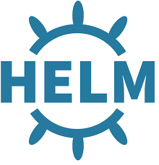
Helm Releases v3 (v3.0.0-beta.3)
The server side component Tiller removed Avoid Security risks
Avoid installation complications
Installation directly runs on the client
No Service account; use existing client accoutns
Namespaces are more important and release is tagged to that.
One can install multiple instances name each for each namespace with same name. Releases are stored as secrets in the namespace
All of the Helm 2 flags still lworks
Lua templates are going to be introduced alongside Go templates (some points in future).
Introduced Library charts - simply define templates for your other Helm charts to use. Store common information about your applications, without needing to replicate it across multiple Helm charts. Library chart declare in Chart.yaml as dependencies.

Slide 12
Helm Releases v3 .. more.....
As part of the Design Proposal (some are alredy in helm3)
●
Tiller is gone, and there is only one functional component (helm)
Charts are updated with libraries, schematized values, and the ext directory Helm will use a "lifecycle events" emitter/handler model.
Helm has an embedded Lua engine for scripting some event handlers. Scripts are stored in charts.
State is maintained with two types of object: Release and a release version Secret
Resources created by hooks will now be managed
For pull-based DevOps workflow, a new Helm Controller project will be started Cross platform plugins in Lua that only have a runtime dependency on Helm A complementary command to helm fetch to push packages to a repository
More Design details here: https://github.com/helm/community/tree/master/helm-v3
●
●
●
●
●
●
●
●

Slide 13
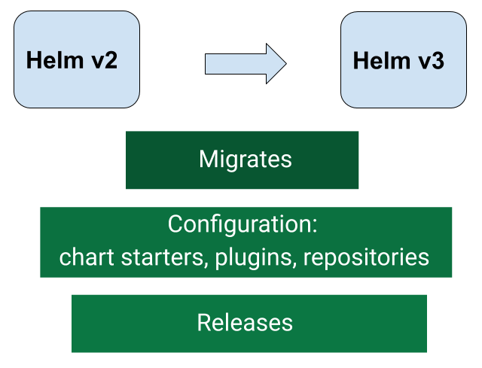
Migrate from Helm v2 to v3
Helm v3 introduces quite a lot of changes.
Both Helm can coexist in the system at present.
helm-2to3 plugin will allow us to migrate Helm v2 configuration and releases to Helm v3 (installed k8s objects will not be touched)
Migrate everything in place to helm 3
--delete-v2-releases : will delete the helm2 release
--tiller-out-cluster: Tiller is not running in the cluster
In Chart v3 few changes are in place: requirements.yaml moved to Charts.yaml requirements.lock moved to Charts.lock

Slide 14
Helm & Operators together..
●
Build Operator with Helm chart using Operator SDK Helm is glorified templating tool.
Helm Templatization by values.yaml file & Orchestration via Hooks
Same helm for deploying applications (manifests) & control planes (operator) Operator is kubernative objects - Custom Resource/API + Custom Controller Helm chart config through value.yaml or configMap.
Add vaidation rule in CRD Yaml file
Register CRDs using Helm charts instead of Operator Go code. Add annotations to enable CR discovery & binding
More -
●
●
●
●
●
●
●
●
●
●
https://static.sched.com/hosted_files/helmsummit2019/ac/Operators-and-Helm-It-takes-two-to-tan go.pdf
https://docs.okd.io/latest/operators/osdk-helm.html
●

Slide 15
DEMO
Helm in GKE (Google Kubernetes Engine)

Slide 16

In Demo, we have gone through...
1)Created GKE cluster 2)Installed helm 2 & helm3
3)Deployed app using helm2 & helm3 4)Installed Plugin hel2to3
Migrated app from helm2 to helm3
Created a new application, build & deploy using helm3
Modifed the application, build & deploy using helm3 8)Added a library chart & schema validation
Added a Operators to the chart & also upgrade
Run kubectl, docker, gcloud commands to see the status at various stages

Slide 17
Summary
k8s Application deployment methods
Helm helps manage Kubernetes applications
New release Helm3 Beta is now available with major chnages
Library charts, Lua templates & Schema validation are new features in helm3 helm2 is in production / currently used
Migration to Helm 3 from version 2 is available as a plugin. Operators and Helm can co-exists.
✔
✔
✔
✔
✔
✔
✔

